Slide 1
Lectures of Stat -145
(Biostatistics)
Text book
Biostatistics
Basic Concepts and Methodology for the Health Sciences
By
Wayne W. Daniel
Prepared By:
Sana A. Abunasrah

Slide 2
Chapter 1
Introduction To
Biostatistics

Slide 3
Key words :
  Statistics , data , Biostatistics,
  Variable ,Population ,Sample

Slide 4
Introduction
Some Basic concepts
Statistics is a field of study concerned with
1- collection, organization, summarization and analysis of data.
2- drawing of inferences about a body of data when only a part of the data is observed.
Statisticians try to interpret and
communicate the results to others.

Slide 5
* Biostatistics:
The tools of statistics are employed in many fields:
business, education, psychology, agriculture, economics, … etc.
When the data analyzed are derived from the biological science and medicine,
we use the term biostatistics to distinguish this particular application of statistical tools and concepts.

Slide 6
Data:
The raw material of Statistics is data.
We may define data as figures. Figures result from the process of counting or from taking a measurement.
For example:
- When a hospital administrator counts the number of patients (counting).
- When a nurse weighs a patient (measurement)

Slide 7
* Sources of Data:
We search for suitable data to serve as the raw material for our investigation.
Such data are available from one or more of the following sources:
1- Routinely kept records.
For example:
- Hospital medical records contain immense amounts of information on patients.
Hospital accounting records contain a wealth of data on the facility’s business
activities.

Slide 8
2- External sources.
The data needed to answer a question may already exist in the form of
published reports, commercially available data banks, or the research literature, i.e. someone else has already asked the same question.

Slide 9
3- Surveys:
The source may be a survey, if the data needed is about answering certain questions.
For example:
If the administrator of a clinic wishes to obtain information regarding the mode of transportation used by patients to visit the clinic,
then a survey may be conducted among
patients to obtain this information.

Slide 10
4- Experiments.
Frequently the data needed to answer
a question are available only as the
result of an experiment.
For example:
If a nurse wishes to know which of several strategies is best for maximizing patient compliance,
she might conduct an experiment in which the different strategies of motivating compliance
are tried with different patients.

Slide 11
* A variable:
It is a characteristic that takes on different values in different persons, places, or things.
For example:
- heart rate,
- the heights of adult males,
- the weights of preschool children,
- the ages of patients seen in a dental clinic.

Slide 12
Types of variables
Quantitative
Qualitative
Quantitative Variables
It can be measured in the usual sense.
For example:
- the heights of adult males,
- the weights of preschool children,
the ages of patients seen in a
dental clinic.
Qualitative Variables
Many characteristics are not capable of being measured. Some of them can be ordered or ranked.
For example:
- classification of people into socio-economic groups,
- social classes based on income, education, etc.

Slide 13
Types of quantitative variables
Discrete
Continuous
A discrete variable
is characterized by gaps or interruptions in the values that it can assume.
For example:
- The number of daily admissions to a general hospital,
The number of decayed, missing or filled teeth per child
in an
elementary
school.
A continuous variable
can assume any value within a specified relevant interval of values assumed by the variable.
For example:
Height,
weight,
skull circumference.
No matter how close together the observed heights of two people, we can find another person whose height falls somewhere in between.

Slide 14
* A population:
It is the largest collection of values of a random variable for which we have an interest at a particular time.
For example:
The weights of all the children enrolled in a certain elementary school.
Populations may be finite or infinite.

Slide 15
* A sample:
It is a part of a population.
For example:
The weights of only a fraction of these children.

Slide 16
Excercises
Question (6) – Page 17
Question (7) – Page 17
“ Situation A , Situation B “

Slide 17
Chapter ( 2 )
Strategies for understanding the meanings of Data
Pages( 19 – 27)

Slide 18
Key words
frequency table, bar chart ,range
width of interval , mid-interval
Histogram , Polygon

Slide 19
Descriptive Statistics
Frequency Distribution for Discrete Random Variables
Example:
Suppose that we take a sample of size 16 from children in a primary school and get the following data about the number of their decayed teeth,
3,5,2,4,0,1,3,5,2,3,2,3,3,2,4,1
To construct a frequency table:
1- Order the values from the smallest to the largest.
0,1,1,2,2,2,2,3,3,3,3,3,4,4,5,5
2- Count how many numbers are the same.
No. of decayed teeth | Frequency | Relative Frequency
0 1 2 3 4 5 | 1 2 4 5 2 2 | 0.0625 0.125 0.25 0.3125 0.125 0.125
Total | 16 | 1

Slide 20
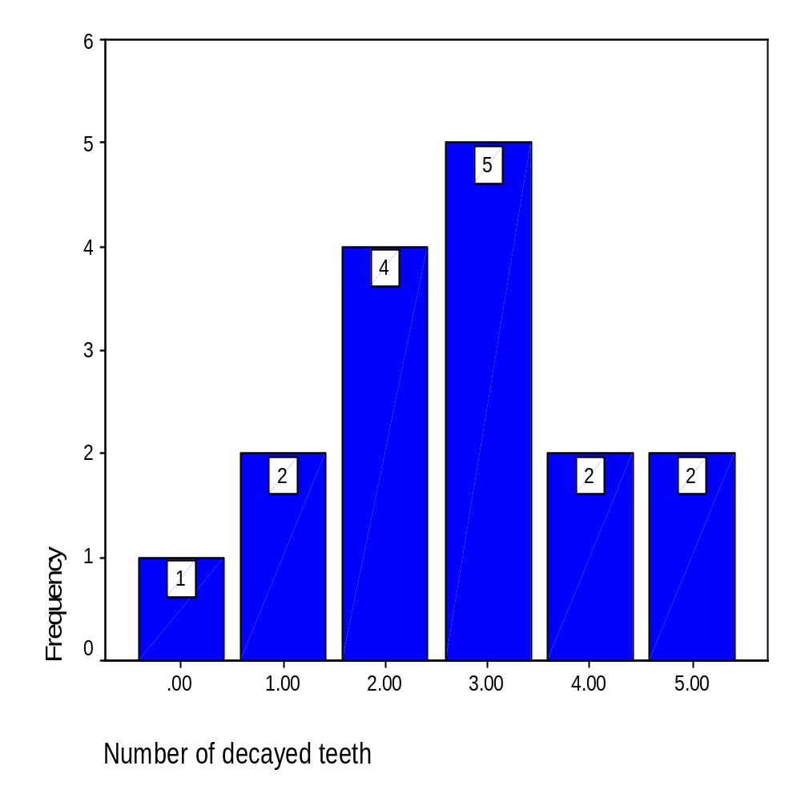
Representing the simple frequency table using the bar chart
We can represent the above simple frequency table using the bar chart.

Slide 21
2.3 Frequency Distribution for Continuous Random Variables
For large samples, we can’t use the simple frequency table to represent the data.
We need to divide the data into groups or intervals or classes.
So, we need to determine:
1- The number of intervals (k).
Too few intervals are not good because information will be lost.
Too many intervals are not helpful to summarize the data.
A commonly followed rule is that 6 ≤ k ≤ 15,
or the following formula may be used,
k = 1 + 3.322 (log n)

Slide 22
2- The range (R).
It is the difference between the largest and the smallest observation in the data set.
3- The Width of the interval (w).
Class intervals generally should be of the same width. Thus, if we want k intervals, then w is chosen such that
w ≥ R / k.

Slide 23
Example:
Assume that the number of observations
equal 100, then
k = 1+3.322(log 100)
= 1 + 3.3222 (2) = 7.6 ≅ 8.
Assume that the smallest value = 5 and the largest one of the data = 61, then
R = 61 – 5 = 56 and
w = 56 / 8 = 7.
To make the summarization more comprehensible, the class width may be 5 or 10 or the multiples of 10.

Slide 24
Example 2.3.1
We wish to know how many class interval to have in the frequency distribution of the data in Table 1.4.1 Page 9-10 of ages of 189 subjects who Participated in a study on smoking cessation
Solution :
Since the number of observations
equal 189, then
k = 1+3.322(log 169)
= 1 + 3.3222 (2.276) ≅ 9,
R = 82 – 30 = 52 and
w = 52 / 9 = 5.778
It is better to let w = 10, then the intervals
will be in the form:

Slide 25
Class interval | Frequency
30 – 39 | 11
40 – 49 | 46
50 – 59 | 70
60 – 69 | 45
70 – 79 | 16
80 – 89 | 1
Total | 189
Sum of frequency
=sample size=n

Slide 26
The Cumulative Frequency:
It can be computed by adding successive frequencies.
The Cumulative Relative Frequency:
It can be computed by adding successive relative frequencies.
The Mid-interval:
It can be computed by adding the lower bound of the interval plus the upper bound of it and then divide over 2.

Slide 27
For the above example, the following table represents the cumulative frequency, the relative frequency, the cumulative relative frequency and the mid-interval.
R.f= freq/n
Class interval | Mid –interval | Frequency Freq (f) | Cumulative Frequency | Relative Frequency R.f | Cumulative Relative Frequency
30 – 39 | 34.5 | 11 | 11 | 0.0582 | 0.0582
40 – 49 | 44.5 | 46 | 57 | 0.2434 | -
50 – 59 | 54.5 | - | 127 | - | 0.6720
60 – 69 | - | 45 | - | 0.2381 | 0.9101
70 – 79 | 74.5 | 16 | 188 | 0.0847 | 0.9948
80 – 89 | 84.5 | 1 | 189 | 0.0053 | 1
Total |  | 189 |  | 1

Slide 28
Example :
From the above frequency table, complete the table then answer the following questions:
1-The number of objects with age less than 50 years ?
2-The number of objects with age between 40-69 years ?
3-Relative frequency of objects with age between 70-79 years ?
4-Relative frequency of objects with age more than 69 years ?
5-The percentage of objects with age between 40-49 years ?

Slide 29
6- The percentage of objects with age less than 60 years ?
7-The Range (R) ?
8- Number of intervals (K)?
9- The width of the interval ( W) ?

Slide 30
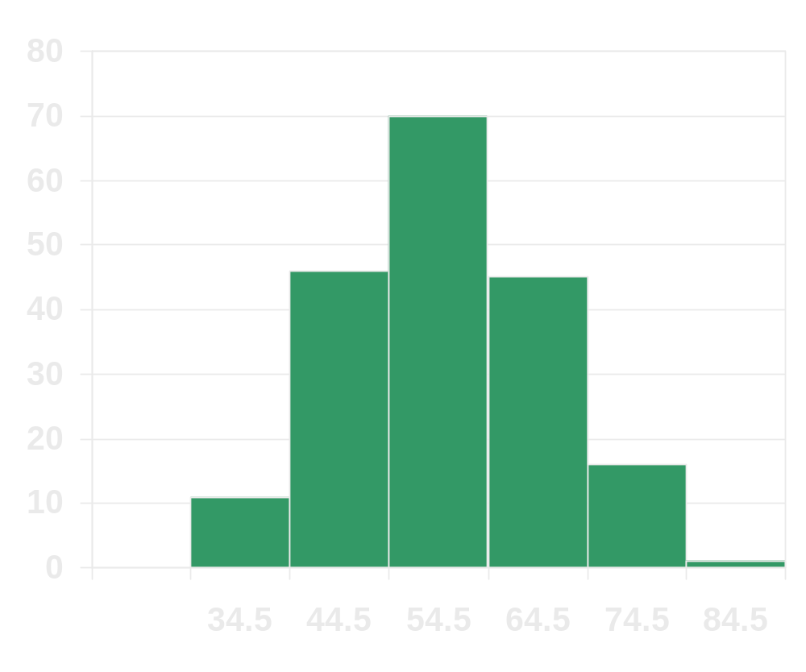
Representing the grouped frequency table using the histogram
To draw the histogram, the true classes limits should be used. They can be computed by subtracting 0.5 from the lower limit and adding 0.5 to the upper limit for each interval.
True class limits | Frequency
29.5 – <39.5 | 11
39.5 – < 49.5 | 46
49.5 – < 59.5 | 70
59.5 – < 69.5 | 45
69.5 – < 79.5 | 16
79.5 – < 89.5 | 1
Total | 189

Slide 31

Representing the grouped frequency table using the Polygon

Slide 32
Exercises
Pages : 31 – 34
Questions: 2.3.2(a) , 2.3.5 (a)
H.W. : 2.3.6 , 2.3.7(a)

Slide 33
Section (2.4) :
Descriptive Statistics Measures of Central Tendency
Page 38 - 41

Slide 34
key words:
Descriptive Statistic, measure of central tendency ,statistic, parameter, mean (μ) ,median, mode.

Slide 35
The Statistic and The Parameter
A Statistic:
It is a descriptive measure computed from the data of a sample.
A Parameter:
It is a a descriptive measure computed from the data of a population.
Since it is difficult to measure a parameter from the population, a sample is drawn of size n, whose values are χ ₁ , χ ₂ , …, χ _{n}. From this data, we measure the statistic.

Slide 36

Measures of Central Tendency
A measure of central tendency is a measure which indicates where the middle of the data is.
The three most commonly used measures of central tendency are:
The Mean, the Median, and the Mode.
The Mean:
It is the average of the data.

Slide 37
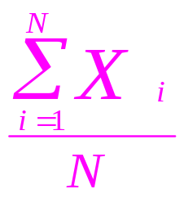
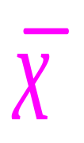
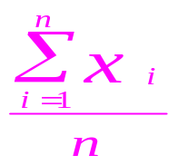
The Population Mean:
μ = which is usually unknown, then we use the
sample mean to estimate or approximate it.
The Sample Mean:
=
Example:
Here is a random sample of size 10 of ages, where
χ ₁ = 42, χ ₂ = 28, χ ₃ = 28, χ ₄ = 61, χ ₅ = 31,
χ ₆ = 23, χ ₇ = 50, χ ₈ = 34, χ ₉ = 32, χ ₁₀ = 37.
= (42 + 28 + … + 37) / 10 = 36.6

Slide 38
Properties of the Mean:
Uniqueness. For a given set of data there is one and only one mean.
Simplicity. It is easy to understand and to compute.
Affected by extreme values. Since all values enter into the computation.
Example: Assume the values are 115, 110, 119, 117, 121 and 126. The mean = 118.
But assume that the values are 75, 75, 80, 80 and 280. The mean = 118, a value that is not representative of the set of data as a whole.

Slide 39
The Median:
When ordering the data, it is the observation that divide the set of observations into two equal parts such that half of the data are before it and the other are after it.
* If n is odd, the median will be the middle of observations. It will be the (n+1)/2 ^{th} ordered observation.
When n = 11, then the median is the 6th observation.
* If n is even, there are two middle observations. The median will be the mean of these two middle observations. It will be the (n+1)/2 ^{th} ordered observation.
When n = 12, then the median is the 6.5th observation, which is an observation halfway between the 6th and 7th ordered observation.

Slide 40
Example:
For the same random sample, the ordered observations will be as:
23, 28, 28, 31, 32, 34, 37, 42, 50, 61.
Since n = 10, then the median is the 5.5th observation, i.e. = (32+34)/2 = 33.
Properties of the Median:
Uniqueness. For a given set of data there is one and only one median.
Simplicity. It is easy to calculate.
It is not affected by extreme values as is the mean.

Slide 41
The Mode:
It is the value which occurs most frequently.
If all values are different there is no mode.
Sometimes, there are more than one mode.
Example:
For the same random sample, the value 28 is repeated two times, so it is the mode.
Properties of the Mode:
Sometimes, it is not unique.
It may be used for describing qualitative data.

Slide 42
Section (2.5) :
Descriptive Statistics Measures of Dispersion
Page 43 - 46

Slide 43
key words:
Descriptive Statistic, measure of dispersion , range ,variance, coefficient of variation.

Slide 44
2.5. Descriptive Statistics – Measures of Dispersion:
A measure of dispersion conveys information regarding the amount of variability present in a set of data.
Note:
If all the values are the same
→ There is no dispersion .
2. If all the values are different
→ There is a dispersion:
3.If the values close to each other
→The amount of Dispersion small.
b) If the values are widely scattered
→ The Dispersion is greater.

Slide 45
Ex. Figure 2.5.1 –Page 43
** Measures of Dispersion are :
1.Range (R).
2. Variance.
3. Standard deviation.
4.Coefficient of variation (C.V).

Slide 46
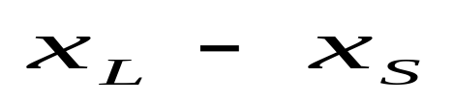
1.The Range (R):
Range =Largest value- Smallest value =
Note:
Range concern only onto two values
Example 2.5.1 Page 40:
Refer to Ex 2.4.2.Page 37
Data:
43,66,61,64,65,38,59,57,57,50.
Find Range?
Range=66-38=28

Slide 47
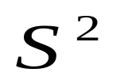
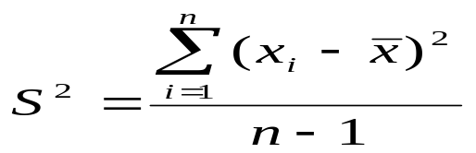

2.The Variance:
It measure dispersion relative to the scatter of the values a bout there mean.
a) Sample Variance ( ) :
,where is sample mean
Example 2.5.2 Page 40:
Refer to Ex 2.4.2.Page 37
Find Sample Variance of ages , = 56
Solution:
S²= [(43-56) ² +(66-43) ²+…..+(50-56) ² ]/ 10
= 900/10 = 90

Slide 48
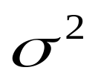
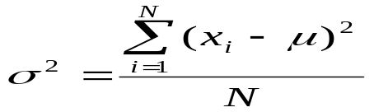
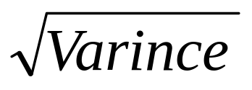
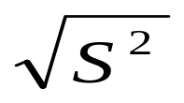
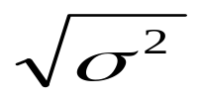
b)Population Variance ( ) :
where , is Population mean
3.The Standard Deviation:
is the square root of variance=
a) Sample Standard Deviation = S =
b) Population Standard Deviation = σ =

Slide 49
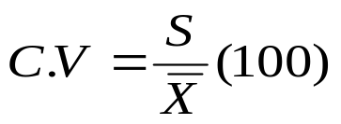
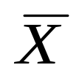
4.The Coefficient of Variation (C.V):
Is a measure use to compare the dispersion in two sets of data which is independent of the unit of the measurement .
where S: Sample standard deviation.
: Sample mean.

Slide 50
Example 2.5.3 Page 46:
Suppose two samples of human males yield the following data:
Sampe1 Sample2
Age 25-year-olds 11year-olds
Mean weight 145 pound 80 pound
Standard deviation 10 pound 10 pound

Slide 51
We wish to know which is more variable.
Solution:
c.v (Sample1)= (10/145)*100= 6.9
c.v (Sample2)= (10/80)*100= 12.5
Then age of 11-years old(sample2) is more variation

Slide 52
Exercises
Pages : 52 – 53
Questions: 2.5.1 , 2.5.2 ,2.5.3
H.W. :2.5.4 , 2.5.5, 2.5.6, 2.5.14
* Also you can solve in the review questions page 57:
Q: 12,13,14,15,16, 19

Slide 53
Chapter 3
Probability
The Basis of the Statistical inference

Slide 54
Key words:
Probability, objective Probability,
subjective Probability, equally likely
Mutually exclusive, multiplicative rule
Conditional Probability, independent events, Bayes theorem

Slide 55
3.1 Introduction
The concept of probability is frequently encountered in everyday communication. For example, a physician may say that a patient has a 50-50 chance of surviving a certain operation. Another physician may say that she is 95 percent certain that a patient has a particular disease.
Most people express probabilities in terms of percentages.
But, it is more convenient to express probabilities as fractions. Thus, we may measure the probability of the occurrence of some event by a number between 0 and 1.
The more likely the event, the closer the number is to one. An event that can't occur has a probability of zero, and an event that is certain to occur has a probability of one.

Slide 56

3.2 Two views of Probability objective and subjective:
*** Objective Probability
** Classical and Relative
Some definitions:
1.Equally likely outcomes:
Are the outcomes that have the same chance of occurring.
2.Mutually exclusive:
Two events are said to be mutually exclusive if they cannot occur simultaneously such that A B =Φ .

Slide 57
The universal Set (S): The set all possible outcomes.
The empty set Φ : Contain no elements.
The event ,E : is a set of outcomes in S which has a certain characteristic.
Classical Probability : If an event can occur in N mutually exclusive and equally likely ways, and if m of these possess a triat, E, the probability of the occurrence of event E is equal to m/ N .
For Example: in the rolling of the die , each of the six sides is equally likely to be observed . So, the probability that a 4 will be observed is equal to 1/6.

Slide 58
Relative Frequency Probability:
Def: If some posses is repeated a large number of times, n, and if some resulting event E occurs m times , the relative frequency of occurrence of E , m/n will be approximately equal to probability of E . P(E) = m/n .
*** Subjective Probability :
Probability measures the confidence that a particular individual has in the truth of a particular proposition.
For Example : the probability that a cure for cancer will be discovered within the next 10 years.

Slide 59
3.3 Elementary Properties of Probability:
Given some process (or experiment ) with n mutually exclusive events E₁, E₂, E₃,…………, E_{n}, then
1-P(E_{i} ) 0, i= 1,2,3,……n
2- P(E₁ )+ P(E₂) +……+P(E_{n} )=1
3- P(E_{i} +E_{J} )= P(E_{i} )+ P(E_{J} ), E_{i} ,E_{J} are mutually exclusive

Slide 60
Rules of Probability
1-Addition Rule
P(A U B)= P(A) + P(B) – P (A∩B )
2- If A and B are mutually exclusive (disjoint) ,then
P (A∩B ) = 0
Then , addition rule is
P(A B)= P(A) + P(B) .
3- Complementary Rule
P(A' )= 1 – P(A)
where, A' = = complement event
Consider example 3.4.1 Page 63

Slide 61
Table 3.4.1 in Example 3.4.1
Family history of Mood Disorders | Early = 18 (E) | Later >18 (L) | Total
Negative(A) | 28 | 35 | 63
Bipolar Disorder(B) | 19 | 38 | 57
Unipolar (C) | 41 | 44 | 85
Unipolar and Bipolar(D) | 53 | 60 | 113
Total | 141 | 177 | 318

Slide 62

**Answer the following questions:
Suppose we pick a person at random from this sample.
1-The probability that this person will be 18-years old or younger?
2-The probability that this person has family history of mood orders Unipolar(C)?
3-The probability that this person has no family history of mood orders Unipolar( )?
4-The probability that this person is 18-years old or younger or has no family history of mood orders Negative (A)?
5-The probability that this person is more than18-years old and has family history of mood orders Unipolar and Bipolar(D)?

Slide 63
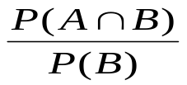
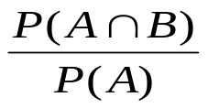
Conditional Probability:
P(A\B) is the probability of A assuming that B has happened.
P(A\B)= , P(B)≠ 0
P(B\A)= , P(A)≠ 0

Slide 64
Example 3.4.2 Page 64
From previous example 3.4.1 Page 63 , answer
suppose we pick a person at random and find he is 18 years or younger (E),what is the probability that this person will be one who has no family history of mood disorders (A)?
suppose we pick a person at random and find he has family history of mood (D) what is the probability that this person will be 18 years or younger (E)?

Slide 65
Calculating a joint Probability :
Example 3.4.3.Page 64
Suppose we pick a person at random from the 318 subjects. Find the probability that he will early (E) and has no family history of mood disorders (A).

Slide 66
Multiplicative Rule:
P(A∩B)= P(A\B)P(B)
P(A∩B)= P(B\A)P(A)
Where,
P(A): marginal probability of A.
P(B): marginal probability of B.
P(B\A):The conditional probability.

Slide 67
Example 3.4.4 Page 65
From previous example 3.4.1 Page 63 , we wish to compute the joint probability of Early age at onset(E) and a negative family history of mood disorders(A) from a knowledge of an appropriate marginal probability and an appropriate conditional probability.
Exercise: Example 3.4.5.Page 66
Exercise: Example 3.4.6.Page 67

Slide 68
Independent Events:
If A has no effect on B, we said that A,B are independent events.
Then,
1- P(A∩B)= P(B)P(A)
2- P(A\B)=P(A)
3- P(B\A)=P(B)

Slide 69
Example 3.4.7 Page 68
In a certain high school class consisting of 60 girls and 40 boys, it is observed that 24 girls and 16 boys wear eyeglasses . If a student is picked at random from this class ,the probability that the student wears eyeglasses , P(E), is 40/100 or 0.4 .
What is the probability that a student picked at random wears eyeglasses given that the student is a boy?
What is the probability of the joint occurrence of the events of wearing eye glasses and being a boy?

Slide 70

Example 3.4.8 Page 69
Suppose that of 1200 admission to a general hospital during a certain period of time,750 are private admissions. If we designate these as a set A, then compute P(A) , P( ).
Exercise: Example 3.4.9.Page 76

Slide 71



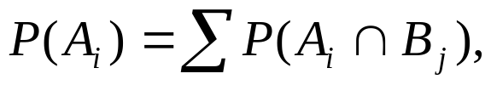
Marginal Probability:
Definition:
Given some variable that can be broken down into m categories designated
by and another jointly occurring variable that is broken down into n categories designated by
, the marginal probability of with all the categories of B . That is,
for all value of j
Example 3.4.9.Page 76
Use data of Table 3.4.1, and rule of marginal Probabilities to calculate P(E).

Slide 72
Exercise:
Page 76-77
Questions :
3.4.1, 3.4.3,3.4.4
H.W.
3.4.5 , 3.4.7

Slide 73
Baye's Theorem
Pages 79-83

Slide 74
Definition.1
The sensitivity of the symptom
This is the probability of a positive result given that the subject has the disease. It is denoted by P(T|D)
Definition.2
The specificity of the symptom
This is the probability of negative result given that the subject does not have the disease. It is denoted by

Slide 75
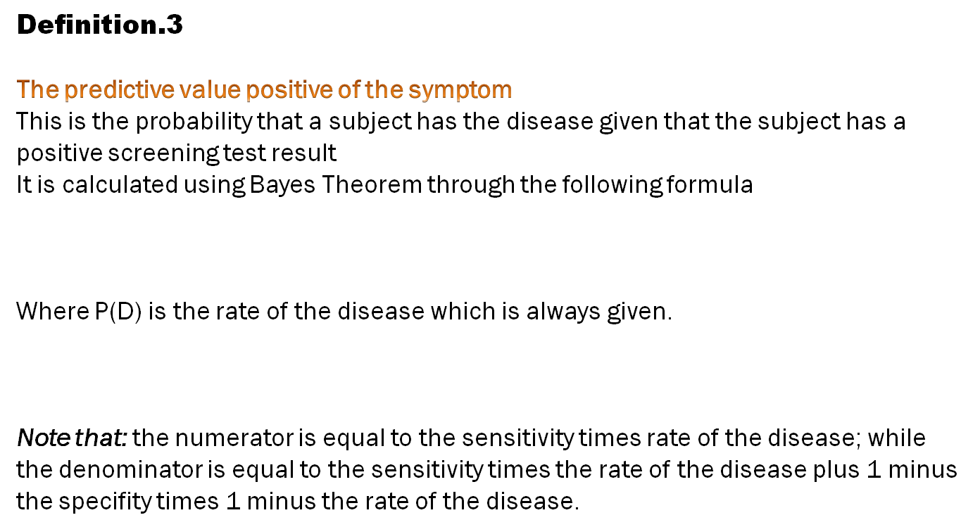
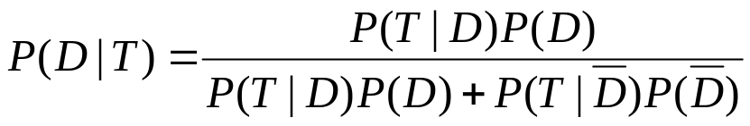
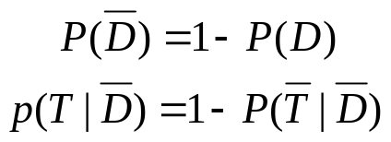

Slide 76
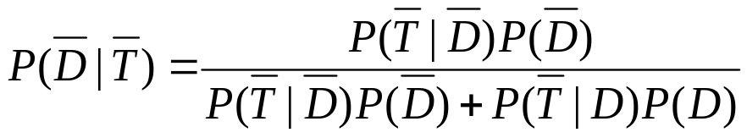
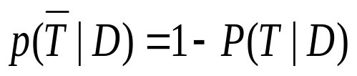
Definition.4
The predictive value negative of the symptom
This is the probability that a subject does not have the disease given that the subject has a negative screening test result
It is calculated using Bayes Theorem through the following formula
where,

Slide 77


Example 3.5.1 page 82
A medical research team wished to evaluate a proposed screening test for Alzheimer’s disease. The test was given to a random sample of 450 patients with Alzheimer’s disease and an independent random sample of 500 patients without symptoms of the disease. The two samples were drawn from populations of subjects who were 65 years or older. The results are as follows.
Test Result | Yes (D) | No ( ) | Total
Positive(T) | 436 | 5 | 441
Negativ( ) | 14 | 495 | 509
Total | 450 | 500 | 950

Slide 78
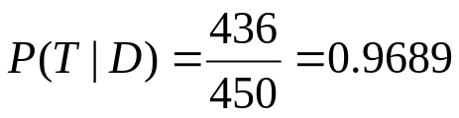
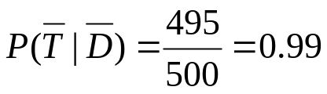
In the context of this example
What is a false positive?
A false positive is when the test indicates a positive result (T) when the person does not have the disease
b) What is the false negative?
A false negative is when a test indicates a negative result ( ) when the person has the disease (D).
c) Compute the sensitivity of the symptom.
d) Compute the specificity of the symptom.

Slide 79
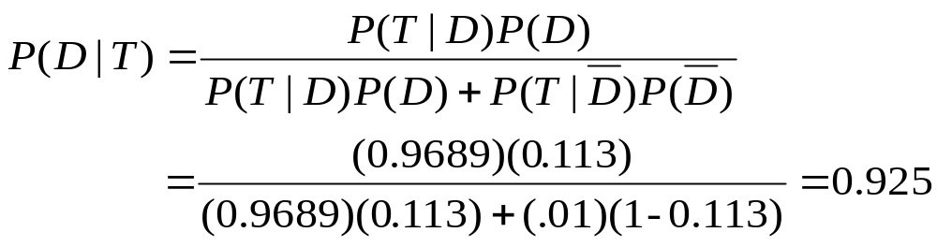
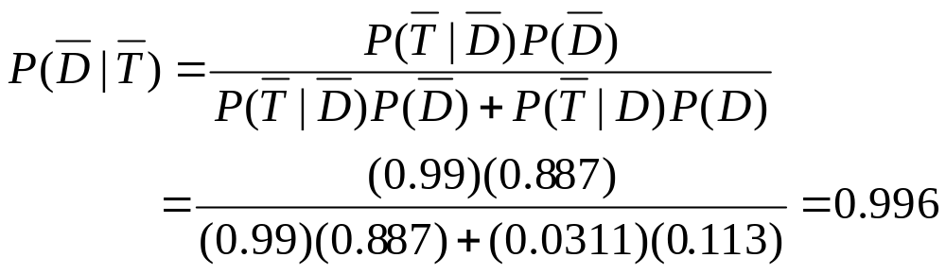
e) Suppose it is known that the rate of the disease in the general population is 11.3%. What is the predictive value positive of the symptom and the predictive value negative of the symptom
The predictive value positive of the symptom is calculated as
The predictive value negative of the symptom is calculated as

Slide 80
Exercise:
Page 83
Questions :
3.5.1, 3.5.2
H.W.:
Page 87 : Q4,Q5,Q7,Q9,Q21

Slide 81
Chapter 4:
Probabilistic features of certain data Distributions
Pages 93- 111

Slide 82
Key words
Probability distribution , random variable ,
Bernolli distribution, Binomail distribution,
Poisson distribution

Slide 83
The Random Variable (X):
When the values of a variable (height, weight, or age) can’t be predicted in advance, the variable is called a random variable.
An example is the adult height.
When a child is born, we can’t predict exactly his or her height at maturity.

Slide 84
4.2 Probability Distributions for Discrete Random Variables
Definition:
The probability distribution of a discrete random variable is a table, graph, formula, or other device used to specify all possible values of a discrete random variable along with their respective probabilities.

Slide 85
The Cumulative Probability Distribution of X, F(x):
It shows the probability that the variable X is less than or equal to a certain value, P(X ≤ x).

Slide 86
Example 4.2.1 page 94:
Number of Programs | frequency | P(X=x) | F(x)= P(X≤ x)
1 | 62 | 0.2088 | 0.2088
2 | 47 | 0.1582 | 0.3670
3 | 39 | 0.1313 | 0.4983
4 | 39 | 0.1313 | 0.6296
5 | 58 | 0.1953 | 0.8249
6 | 37 | 0.1246 | 0.9495
7 | 4 | 0.0135 | 0.9630
8 | 11 | 0.0370 | 1.0000
Total | 297 | 1.0000

Slide 87
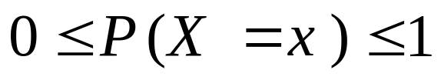
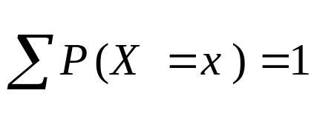
See figure 4.2.1 page 96
See figure 4.2.2 page 97
Properties of probability distribution of discrete random variable.
1.
2.
3. P(a ≤ X ≤ b) = P(X ≤ b) – P(X ≤ a-1)
4. P(X < b) = P(X ≤ b-1)

Slide 88
Example 4.2.2 page 96: (use table in example 4.2.1)
What is the probability that a randomly selected family will be one who used three assistance programs?
Example 4.2.3 page 96: (use table in example 4.2.1)
What is the probability that a randomly selected family used either one or two programs?

Slide 89
Example 4.2.4 page 98: (use table in example 4.2.1)
What is the probability that a family picked at random will be one who used two or fewer assistance programs?
Example 4.2.5 page 98: (use table in example 4.2.1)
What is the probability that a randomly selected family will be one who used fewer than four programs?
Example 4.2.6 page 98: (use table in example 4.2.1)
What is the probability that a randomly selected family used five or more programs?

Slide 90
Example 4.2.7 page 98: (use table in example 4.2.1)
What is the probability that a randomly selected family is one who used between three and five programs, inclusive?

Slide 91
4.3 The Binomial Distribution:
The binomial distribution is one of the most widely encountered probability distributions in applied statistics. It is derived from a process known as a Bernoulli trial.
Bernoulli trial is :
When a random process or experiment called a trial can result in only one of two mutually exclusive outcomes, such as dead or alive, sick or well, the trial is called a Bernoulli trial.

Slide 92
The Bernoulli Process
A sequence of Bernoulli trials forms a Bernoulli process under the following conditions
1- Each trial results in one of two possible, mutually exclusive, outcomes. One of the possible outcomes is denoted (arbitrarily) as a success, and the other is denoted a failure.
2- The probability of a success, denoted by p, remains constant from trial to trial. The probability of a failure, 1-p, is denoted by q.
3- The trials are independent, that is the outcome of any particular trial is not affected by the outcome of any other trial

Slide 93
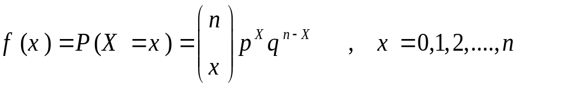
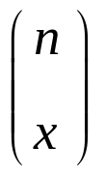
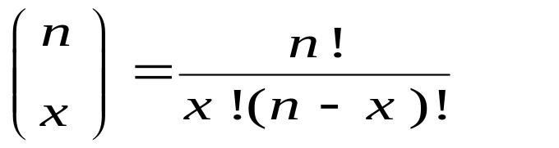
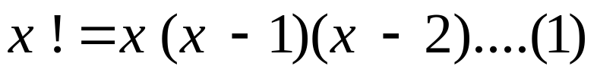
The probability distribution of the binomial random variable X, the number of successes in n independent trials is:
Where is the number of combinations of n distinct objects taken x of them at a time.
* Note: 0! =1

Slide 94
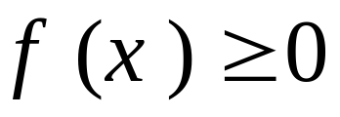
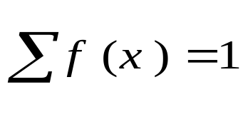

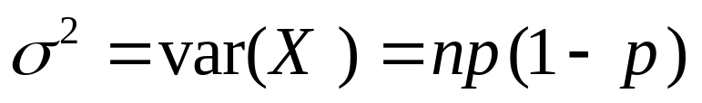
Properties of the binomial distribution
1.
2.
3.The parameters of the binomial distribution are n and p
4.
5.

Slide 95
Example 4.3.1 page 100
If we examine all birth records from the North Carolina State Center for Health statistics for year 2001, we find that 85.8 percent of the pregnancies had delivery in week 37 or later (full- term birth).
If we randomly selected five birth records from this population what is the probability that exactly three of the records will be for full-term births?
Exercise: example 4.3.2 page 104

Slide 96
Example 4.3.3 page 104
Suppose it is known that in a certain population 10 percent of the population is color blind. If a random sample of 25 people is drawn from this population, find the probability that
a) Five or fewer will be color blind.
b) Six or more will be color blind
c) Between six and nine inclusive will be color blind.
d) Two, three, or four will be color blind.
Exercise: example 4.3.4 page 106

Slide 97
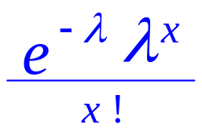

4.4 The Poisson Distribution
If the random variable X is the number of occurrences of some random event in a certain period of time or space (or some volume of matter).
The probability distribution of X is given by:
f (x) =P(X=x) = ,x = 0,1,…..
The symbol e is the constant equal to 2.7183. (Lambda) is called the parameter of the distribution and is the average number of occurrences of the random event in the interval (or volume)

Slide 98

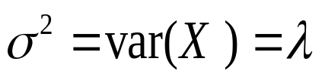
Properties of the Poisson distribution
1.
2.
3.
4.

Slide 99

Example 4.4.1 page 111
In a study of a drug -induced anaphylaxis among patients taking rocuronium bromide as part of their anesthesia, Laake and Rottingen found that the occurrence of anaphylaxis followed a Poisson model with =12 incidents per year in Norway .Find
1- The probability that in the next year, among patients receiving rocuronium, exactly three will experience anaphylaxis?

Slide 100
2- The probability that less than two patients receiving rocuronium, in the next year will experience anaphylaxis?
3- The probability that more than two patients receiving rocuronium, in the next year will experience anaphylaxis?
4- The expected value of patients receiving rocuronium, in the next year who will experience anaphylaxis.
5- The variance of patients receiving rocuronium, in the next year who will experience anaphylaxis
6- The standard deviation of patients receiving rocuronium, in the next year who will experience anaphylaxis

Slide 101
Example 4.4.2 page 111: Refer to example 4.4.1
1-What is the probability that at least three patients in the next year will experience anaphylaxis if rocuronium is administered with anesthesia?
2-What is the probability that exactly one patient in the next year will experience anaphylaxis if rocuronium is administered with anesthesia?
3-What is the probability that none of the patients in the next year will experience anaphylaxis if rocuronium is administered with anesthesia?

Slide 102
4-What is the probability that at most two patients in the next year will experience anaphylaxis if rocuronium is administered with anesthesia?
Exercises: examples 4.4.3, 4.4.4 and 4.4.5 pages111-113
Exercises: Questions 4.3.4 ,4.3.5, 4.3.7 ,4.4.1,4.4.5

Slide 103
4.5 Continuous Probability Distribution
Pages 114 – 127

Slide 104
Key words:
Continuous random variable, normal distribution , standard normal distribution , T-distribution

Slide 105
Now consider distributions of continuous random variables.

Slide 106
Properties of continuous probability Distributions:
1- Area under the curve = 1.
2- P(X = a) = 0 , where a is a constant.
3- Area between two points a , b = P(a<x<b) .

Slide 107
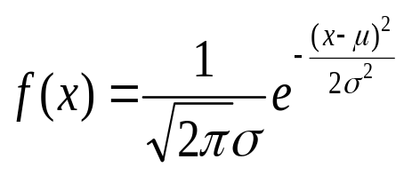
4.6 The normal distribution:
It is one of the most important probability distributions in statistics.
The normal density is given by
, - ∞ < x < ∞, - ∞ < µ < ∞, σ > 0
π, e : constants
µ: population mean.
σ : Population standard deviation.

Slide 108
Characteristics of the normal distribution: Page 111
The following are some important characteristics of the normal distribution:
1- It is symmetrical about its mean, µ.
2- The mean, the median, and the mode are all equal.
3- The total area under the curve above the x-axis is one.
4-The normal distribution is completely determined by the parameters µ and σ.

Slide 109
5- The normal distribution
depends on the two
parameters μ and σ.
determines the
location of
the curve.
(As seen in figure 4.6.3) ,
But, σ determines
the scale of the curve, i.e.
the degree of flatness or
peaked ness of the curve.
(as seen in figure 4.6.4)
μ₁
μ₂
μ₃
μ₁ < μ₂ < μ₃
σ₁
σ₂
σ₃
μ
σ₁ < σ₂ < σ₃

Slide 110
Note that : (As seen in Figure 4.6.2)
1. P( µ- σ < x < µ+ σ) = 0.68
2. P( µ- 2σ< x < µ+ 2σ)= 0.95
3. P( µ-3σ < x < µ+ 3σ) = 0.997

Slide 111
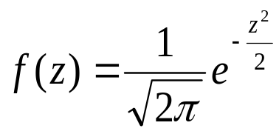
The Standard normal distribution:
Is a special case of normal distribution with mean equal 0 and a standard deviation of 1.
The equation for the standard normal distribution is written as
, - ∞ < z < ∞

Slide 112
Characteristics of the standard normal distribution
1- It is symmetrical about 0.
2- The total area under the curve above the x-axis is one.
3- We can use table (D) to find the probabilities and areas.

Slide 113
“How to use tables of Z”
Note that
The cumulative probabilities P(Z ≤ z) are given in
tables for -3.49 < z < 3.49. Thus,
P (-3.49 < Z < 3.49) ≅ 1.
For standard normal distribution,
P (Z > 0) = P (Z < 0) = 0.5
Example 4.6.1:
If Z is a standard normal distribution, then
P( Z < 2) = 0.9772
is the area to the left to 2
and it equals 0.9772.
2

Slide 114
Example 4.6.2:
P(-2.55 < Z < 2.55) is the area between
-2.55 and 2.55, Then it equals
P(-2.55 < Z < 2.55) =0.9946 – 0.0054
= 0.9892.
Example 4.6.2:
P(-2.74 < Z < 1.53) is the area between
-2.74 and 1.53.
P(-2.74 < Z < 1.53) =0.9370 – 0.0031
= 0.9339.
-2.55
0
2.55
-2.74
1.53

Slide 115
Example 4.6.3:
P(Z > 2.71) is the area to the right to 2.71.
So,
P(Z > 2.71) =1 – 0.9966 = 0.0034.
Example :
P(Z = 0.84) is the area at z = 2.71.
So,
P(Z = 0.84) =1 – 0.9966 = 0.0034
2.71
0.84

Slide 116
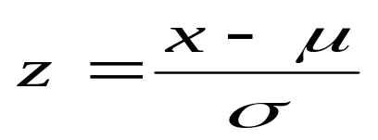
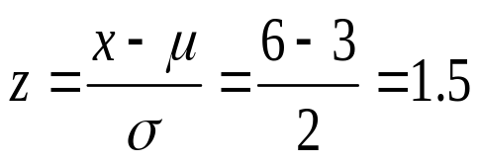
How to transform normal distribution (X) to standard normal distribution (Z)?
This is done by the following formula:
Example:
If X is normal with µ = 3, σ = 2. Find the value of standard normal Z, If X= 6?
Answer:

Slide 117
4.7 Normal Distribution Applications
The normal distribution can be used to model the distribution of many variables that are of interest. This allow us to answer probability questions about these random variables.
Example 4.7.1:
The ‘Uptime ’is a custom-made light weight battery-operated
activity monitor that records the amount of time an individual
spend the upright position. In a study of children ages 8 to 15
years. The researchers found that the amount of time children
spend in the upright position followed a normal distribution with
Mean of 5.4 hours and standard deviation of 1.3.Find

Slide 118
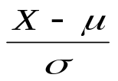
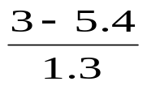
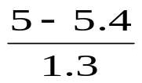
If a child selected at random ,then
1-The probability that the child spend less than 3
hours in the upright position 24-hour period
P( X < 3) = P( < ) = P(Z < -1.85) = 0.0322
-------------------------------------------------------------------------
2-The probability that the child spend more than 5
hours in the upright position 24-hour period
P( X > 5) = P( > ) = P(Z > -0.31)
= 1- P(Z < - 0.31) = 1- 0.3520= 0.648
-----------------------------------------------------------------------
3-The probability that the child spend exactly 6.2
hours in the upright position 24-hour period
P( X = 6.2) = 0

Slide 119
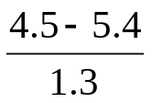
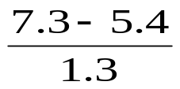
4-The probability that the child spend from 4.5 to 7.3 hours in the upright position 24-hour period
P( 4.5 < X < 7.3) = P( < < )
= P( -0.69 < Z < 1.46 ) = P(Z<1.46) – P(Z< -0.69)
= 0.9279 – 0.2451 = 0.6828
Hw…EX. 4.7.2 – 4.7.3

Slide 120
6.3 The T Distribution:
(167-173)
1- It has mean of zero.
2- It is symmetric about the
mean.
3- It ranges from -∞ to ∞.
0

Slide 121
4- compared to the normal distribution, the t distribution is less peaked in the center and has higher tails.
5- It depends on the degrees of freedom (n-1).
6- The t distribution approaches the standard normal distribution as (n-1) approaches ∞.

Slide 122
Examples
t (7, 0.975) = 2.3646
------------------------------
t (24, 0.995) = 2.7696
--------------------------
If P (T₍₁₈₎ > t) = 0.975,
then t = -2.1009
-------------------------
If P (T₍₂₂₎ < t) = 0.99,
then t = 2.508
0.025
0.975
t _{(7, 0.975)}
0.005
0.995
t _{(24, 0.995)}
0.025
0.975
t
0.01
0.99
t

Slide 123
Exercise:
Questions : 4.7.1, 4.7.2
H.W : 4.7.3, 4.7.4, 4.7.6

Slide 124
Chapter 6
Using sample data to make estimates about population parameters (P162-172)

Slide 125
Key words:
Point estimate, interval estimate, estimator,
Confident level ,α , Confident interval for mean μ, Confident interval for two means,
Confident interval for population proportion P,
Confident interval for two proportions

Slide 126
6.1 Introduction:
Statistical inference is the procedure by which we reach to a conclusion about a population on the basis of the information contained in a sample drawn from that population.
Suppose that:
an administrator of a large hospital is interested in the mean age of patients admitted to his hospital during a given year.
1. It will be too expensive to go through the records of all patients admitted during that particular year.
2. He consequently elects to examine a sample of the records from which he can compute an estimate of the mean age of patients admitted to his that year.

Slide 127
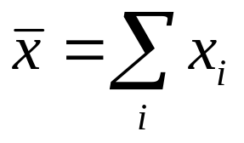
To any parameter, we can compute two types of estimate: a point estimate and an interval estimate.
A point estimate is a single numerical value used to estimate the corresponding population parameter.
An interval estimate consists of two numerical values defining a range of values that, with a specified degree of confidence, we feel includes the parameter being estimated.
The Estimate and The Estimator:
The estimate is a single computed value, but the estimator is the rule that tell us how to compute this value, or estimate.
For example,
is an estimator of the population mean,μ. The single numerical value that results from evaluating this formula is called an estimate of the parameter μ.

Slide 128
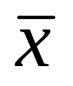
6.2 Confidence Interval for a Population Mean: (C.I)
Suppose researchers wish to estimate the mean of some normally distributed population.
They draw a random sample of size n from the population and compute , which they use as a point estimate of μ.
Because random sampling involves chance, then can’t be expected to be equal to μ.
The value of may be greater than or less than μ.
It would be much more meaningful to estimate μ by an interval.

Slide 129
The 1-α percent confidence interval (C.I.) for μ:
We want to find two values L and U between which μ lies with high probability, i.e.
P( L ≤ μ ≤ U ) = 1-α

Slide 130
For example:
When,
α = 0.01,
then 1- α =
α = 0.05,
then 1- α =
α = 0.05,
then 1- α =

Slide 131

We have the following cases
a) When the population is normal
1) When the variance is known and the sample size is large or small, the C.I. has the form:
P( - Z _{(1- α/2)} σ/√n < μ < + Z _{(1- α/2)} σ/√n) = 1- α
2) When variance is unknown, and the sample size is small, the C.I. has the form:
P( - t _{(1- α/2),n-1} s/√n < μ < + t _{(1- α/2),n-1} s/√n) = 1- α

Slide 132

b) When the population is not normal and n large (n>30)
1) When the variance is known the C.I. has the form:
P( - Z _{(1- α/2)} σ/√n < μ < + Z _{(1- α/2)} σ/√n) = 1- α
2) When variance is unknown, the C.I. has the form:
P( - Z _{(1- α/2)} s/√n < μ < + Z _{(1- α/2)} s/√n) = 1- α

Slide 133

Example 6.2.1 Page 167:
Suppose a researcher , interested in obtaining an estimate of the average level of some enzyme in a certain human population, takes a sample of 10 individuals, determines the level of the enzyme in each, and computes a sample mean of approximately
Suppose further it is known that the variable of interest is approximately normally distributed with a variance of 45. We wish to estimate μ. (α=0.05)

Slide 134


Solution:
1- α=0.95→ α=0.05→ α/2=0.025,
variance = σ² = 45 → σ=√ 45,n=10
95%confidence interval for μ is given by:
P( - Z _{(1- α/2)} σ/√n < μ < + Z _{(1- α/2)} σ/√n) = 1- α
Z _{(1- α/2)} = Z _{0.975} = 1.96 (refer to table D)
Z _{0.975}(σ/√n) =1.96 (√ 45 / √10)=4.1578
22 ± 1.96 (√ 45 / √10) →
(22-4.1578, 22+4.1578) → (17.84, 26.16)
Exercise example 6.2.2 page 169

Slide 135
Example
The activity values of a certain enzyme measured in normal gastric tissue of 35 patients with gastric carcinoma has a mean of 0.718 and a standard deviation of 0.511.We want to construct a 90 % confidence interval for the population mean.
Solution:
Note that the population is not normal,
n=35 (n>30) n is large and σ is unknown ,s=0.511
1- α=0.90→ α=0.1
→ α/2=0.05→ 1-α/2=0.95,

Slide 136

Then 90% confident interval for μ is given by :
P( - Z _{(1- α/2)} s/√n < μ < + Z _{(1- α/2)} s/√n) = 1- α
Z _{(1- α/2)} = Z_{0.95} = 1.645 (refer to table D)
Z _{0.95}(s/√n) =1.645 (0.511/ √35)=0.1421
0.718 ± 1.645 (0.511) / √35→
(0.718-0.1421, 0.718+0.1421) →
(0.576,0.860).
Exercise example 6.2.3 page 164:

Slide 137
Example6.3.1 Page 174:
Suppose a researcher , studied the effectiveness of early weight bearing and ankle therapies following acute repair of a ruptured Achilles tendon. One of the variables they measured following treatment the muscle strength. In 19 subjects, the mean of the strength was 250.8 with standard deviation of 130.9
we assume that the sample was taken from is approximately normally distributed population. Calculate 95% confident interval for the mean of the strength ?

Slide 138

Solution:
1- α=0.95→ α=0.05→ α/2=0.025,
Standard deviation= S = 130.9 ,n=19
95%confidence interval for μ is given by:
P( - t _{(1- α/2),n-1} s/√n < μ < + t _{(1- α/2),n-1} s/√n) = 1- α
t _{(1- α/2),n-1} = t _{0.975,18} = 2.1009 (refer to table E)
t _{0.975,18}(s/√n) =2.1009 (130.9 / √19)=63.1
250.8 ± 2.1009 (130.9 / √19) →
(250.8- 63.1 , 22+63.1) → (187.7, 313.9)
Exercise 6.2.1 ,6.2.2
6.3.2 page 171

Slide 139
6.3 Confidence Interval for the difference between two Population Means: (C.I)
If we draw two samples from two independent population
and we want to get the confident interval for the
difference between two population means , then we have
the following cases :
a) When the population is normal
1) When the variance is known and the sample sizes is large or small, the C.I. has the form:

Slide 140
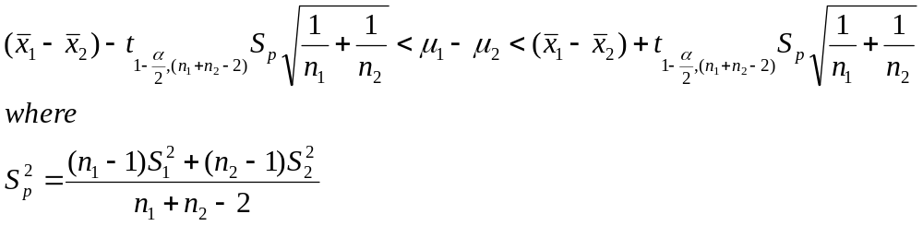
2) When variances are unknown but equal, and the sample size is small, the C.I. has the form:

Slide 141
a) When the population is normal
When the variance is known and the sample sizes is large or small, the C.I. has the form:

Slide 142




Example 6.4.1 P174:
The researcher team interested in the difference between serum uric
and acid level in a patient with and without Down’s syndrome .In a
large hospital for the treatment of the mentally retarded, a sample of
12 individual with Down’s Syndrome yielded a mean of
mg/100 ml. In a general hospital a sample of 15 normal individual of
the same age and sex were found to have a mean value of
If it is reasonable to assume that the two population of values are
normally distributed with variances equal to 1 and 1.5,find the 95%
C.I for μ₁ - μ₂
Solution:
1- α=0.95→ α=0.05→ α/2=0.025 → Z _{(1- α/2)} = Z_{0.975} = 1.96
1.1±1.96(0.4282) = 1.1± 0.84 = ( 0.26 , 1.94 )

Slide 143
Example 6.4.1 P178:
The purpose of the study was to determine the effectiveness of an
integrated outpatient dual-diagnosis treatment program for
mentally ill subject. The authors were addressing the problem of substance abuse
issues among people with sever mental disorder. A retrospective chart review was
carried out on 50 patient ,the recherché was interested in the number of inpatient
treatment days for physics disorder during a year following the end of the program.
Among 18 patient with schizophrenia, The mean number of treatment days was 4.7
with standard deviation of 9.3. For 10 subject with bipolar disorder, the mean
number of treatment days was 8.8 with standard deviation of 11.5. We wish to
construct 99% C.I for the difference between the means of the populations
Represented by the two samples

Slide 144


Solution :
1-α =0.99 → α = 0.01 → α/2 =0.005 → 1- α/2 = 0.995
n₂ – 2 = 18 + 10 -2 = 26+ n₁
t _{(1- α/2),(n1+n2-2)} = t_{0.995,26} = 2.7787, then 99% C.I for μ₁ – μ₂
where
then
(4.7-8.8)± 2.7787 √102.33 √(1/18)+(1/10)
4.1 ± 11.086 =( - 15.186 , 6.986)
Exercises: 6.4.2 , 6.4.6, 6.4.7, 6.4.8 Page 180

Slide 145



6.5 Confidence Interval for a Population proportion (P):
A sample is drawn from the population of interest ,then compute the sample proportion such as
This sample proportion is used as the point estimator of the population proportion . A confident interval is obtained by the following formula

Slide 146
Example 6.5.1
The Pew internet life project reported in 2003 that 18%
of internet users have used the internet to search for
information regarding experimental treatments or
medicine . The sample consist of 1220 adult internet
users, and information was collected from telephone
interview. We wish to construct 98% C.I for the
proportion of internet users who have search for
information about experimental treatments or medicine

Slide 147


Solution :
1-α =0.98 → α = 0.02 → α/2 =0.01 → 1- α/2 = 0.99
Z _{1- α/2} = Z _{0.99} =2.33 , n=1220,
The 98% C. I is
0.18 ± 0.0256 = ( 0.1544 , 0.2056 )
Exercises: 6.5.1 , 6.5.3 Page 187

Slide 148


6.6 Confidence Interval for the difference between two Population proportions :
Two samples is drawn from two independent population
of interest ,then compute the sample proportion for each
sample for the characteristic of interest. An unbiased
point estimator for the difference between two population
proportions
A 100(1-α)% confident interval for P₁ - P₂ is given by

Slide 149
Example 6.6.1
Connor investigated gender differences in proactive and
reactive aggression in a sample of 323 adults (68 female
and 255 males ). In the sample ,31 of the female and 53
of the males were using internet in the internet café. We
wish to construct 99 % confident interval for the
difference between the proportions of adults go to
internet café in the two sampled population .

Slide 150



Solution :
1-α =0.99 → α = 0.01 → α/2 =0.005 → 1- α/2 = 0.995
Z _{1- α/2} = Z _{0.995} =2.58 , n_{F}=68, n_{M}=255,
The 99% C. I is
0.2481 ± 2.58(0.0655) = ( 0.07914 , 0.4171 )

Slide 151
Exercises:
Questions :
6.2.1, 6.2.2,6.2.5 ,6.3.2,6.3.5, 6.4.2
6.5.3 ,6.5.4,6.6.1

Slide 152
Chapter 7
Using sample statistics to Test Hypotheses about population parameters
Pages 215-233

Slide 153
Key words :
Null hypothesis H_{0,} Alternative hypothesis H_{A} , testing hypothesis , test statistic , P-value

Slide 154
Hypothesis Testing
One type of statistical inference, estimation, was discussed in Chapter 6 .
The other type ,hypothesis testing ,is discussed in this chapter.

Slide 155
Definition of a hypothesis
It is a statement about one or more populations .
It is usually concerned with the parameters of the population. e.g. the hospital administrator may want to test the hypothesis that the average length of stay of patients admitted to the hospital is 5 days

Slide 156
Definition of Statistical hypotheses
They are hypotheses that are stated in such a way that they may be evaluated by appropriate statistical techniques.
There are two hypotheses involved in hypothesis testing
Null hypothesis H₀: It is the hypothesis to be tested .
Alternative hypothesis H_{A} : It is a statement of what we believe is true if our sample data cause us to reject the null hypothesis

Slide 157

7.2 Testing a hypothesis about the mean of a population:
We have the following steps:
1.Data: determine variable, sample size (n), sample mean( ) , population standard deviation or sample standard deviation (s) if is unknown
2. Assumptions : We have two cases:
Case1: Population is normally or approximately normally distributed with known or unknown variance (sample size n may be small or large),
Case 2: Population is not normal with known or unknown variance (n is large i.e. n≥30).

Slide 158

3.Hypotheses:
we have three cases
Case I : H₀: μ=μ₀
H_{A}: μ μ₀
e.g. we want to test that the population mean is different than 50
Case II : H₀: μ = μ₀
H_{A}: μ > μ₀
e.g. we want to test that the population mean is greater than 50
Case III : H_{0:} μ = μ₀
H_{A}: μ< μ₀
e.g. we want to test that the population mean is less than 50

Slide 159




4.Test Statistic:
Case 1: population is normal or approximately normal
σ² is known σ² is unknown
( n large or small)
n large n small
Case2: If population is not normally distributed and n is large
i)If σ² is known ii) If σ² is unknown

Slide 160

5.Decision Rule:
i) If H_{A}: μ μ₀
Reject H ₀ if Z >Z_{1-α/2} or Z< - Z_{1-α/2}
(when use Z - test)
Or Reject H ₀ if T >t_{1-α/2,n-1} or T< - t_{1-α/2,n-1}
(when use T- test)
__________________________
ii) If H_{A}: μ> μ₀
Reject H₀ if Z>Z_{1-α} (when use Z - test)
Or Reject H₀ if T>t_{1-α,n-1} (when use T - test)

Slide 161
iii) If H_{A}: μ< μ₀
Reject H₀ if Z< - Z_{1-α} (when use Z - test)
Or
Reject H₀ if T<- t_{1-α,n-1} (when use T - test)
Note:
Z_{1-α/2} , Z_{1-α} , Z_{α} are tabulated values obtained from table D
t_{1-α/2} , t_{1-α} , t_{α} are tabulated values obtained from table E with (n-1) degree of freedom (df)

Slide 162
6.Decision :
If we reject H₀, we can conclude that H_{A} is true.
If ,however ,we do not reject H₀, we may conclude that H₀ is true.

Slide 163
An Alternative Decision Rule using the p - value Definition
The p-value is defined as the smallest value of α for which the null hypothesis can be rejected.
If the p-value is less than or equal to α ,we reject the null hypothesis (p ≤ α)
If the p-value is greater than α ,we do not reject the null hypothesis (p > α)

Slide 164
Example 7.2.1 Page 223
Researchers are interested in the mean age of a certain population.
A random sample of 10 individuals drawn from the population of interest has a mean of 27.
Assuming that the population is approximately normally distributed with variance 20,can we conclude that the mean is different from 30 years ? (α=0.05) .
If the p - value is 0.0340 how can we use it in making a decision?

Slide 165


Solution
1-Data: variable is age, n=10, =27 ,σ²=20,α=0.05
2-Assumptions: the population is approximately normally distributed with variance 20
3-Hypotheses:
H₀ : μ=30
H_{A}: μ 30

Slide 166

4-Test Statistic:
Z = -2.12
5.Decision Rule
The alternative hypothesis is
H_{A}: μ > 30
Hence we reject H0 if Z >Z_{1-0.025/2}= Z_{0.975}
or Z< - Z_{1-0.025/2}= - Z_{0.975}
Z_{0.975}=1.96(from table D)

Slide 167
6.Decision:
We reject H₀ ,since -2.12 is in the rejection region .
We can conclude that μ is not equal to 30
Using the p value ,we note that p-value =0.0340< 0.05,therefore we reject H0

Slide 168
Example7.2.2 page227
Referring to example 7.2.1.Suppose that the researchers have asked: Can we conclude that μ<30.
1.Data.see previous example
2. Assumptions .see previous example
3.Hypotheses:
H₀ μ =30
H_{ِA}: μ < 30

Slide 169



4.Test Statistic :
= = -2.12
5. Decision Rule: Reject H₀ if Z< Z _{α}, where
Z _{α}= -1.645. (from table D)
6. Decision: Reject H₀ ,thus we can conclude that the population mean is smaller than 30.

Slide 170
Example7.2.4 page232
Among 157 African-American men ,the mean systolic blood pressure was 146 mm Hg with a standard deviation of 27. We wish to know if on the basis of these data, we may conclude that the mean systolic blood pressure for a population of African-American is greater than 140. Use α=0.01.

Slide 171



Solution
1. Data: Variable is systolic blood pressure, n=157 , =146, s=27, α=0.01.
2. Assumption: population is not normal, σ² is unknown
3. Hypotheses: H₀ :μ=140
H_{A}: μ>140
4.Test Statistic:
= = = 2.78

Slide 172

5. Desicion Rule:
we reject H₀ if Z>Z_{1-α}
= Z_{0.99}= 2.33
(from table D)
6. Desicion: We reject H₀.
Hence we may conclude that the mean systolic blood pressure for a population of African-American is greater than 140.

Slide 173
7.3 Hypothesis Testing :The Difference between two population mean :
We have the following steps:
1.Data: determine variable, sample size (n), sample means, population standard deviation or samples standard deviation (s) if is unknown for two population.
2. Assumptions : We have two cases:
Case1: Population is normally or approximately normally distributed with known or unknown variance (sample size n may be small or large),
Case 2: Population is not normal with known variances (n is large i.e. n≥30).

Slide 174
3.Hypotheses:
we have three cases
Case I : H₀: μ 1 = μ2 → μ ₁ - μ₂ = 0
H_{A}: μ _{1 ≠} μ ₂ → μ ₁ - μ _{2 ≠ 0}
e.g. we want to test that the mean for first population is different from second population mean.
Case II : H₀: μ 1 = μ2 → μ ₁ - μ₂ = 0
H_{A}: μ _{1 >} μ ₂ → μ ₁ - μ _{2 > 0}
e.g. we want to test that the mean for first population is greater than second population mean.
Case III : H₀: μ 1 = μ2 → μ ₁ - μ₂ = 0
H_{A}: μ _{1 <} μ ₂ → μ ₁ - μ _{2 < 0}
e.g. we want to test that the mean for first population is greater than second population mean.

Slide 175




4.Test Statistic:
Case 1: Two population is normal or approximately normal
σ² is known σ² is unknown if ( n₁ ,n₂ large or small) ( n₁ ,n₂ small)
population population Variances
Variances equal not equal
where

Slide 176
Case2: If population is not normally distributed
and n_{1,} n₂ is large(n₁ ≥ 0 ,n₂≥ 0)
and population variances is known,

Slide 177
5.Decision Rule:
i) If H_{A}: μ _{1 ≠} μ ₂ → μ ₁ - μ _{2 ≠ 0}
Reject H ₀ if Z >Z_{1-α/2} or Z< - Z_{1-α/2}
(when use Z - test)
Or Reject H ₀ if T >t_{1-α/2 ,(n1+n2 -2)} or T< - t_{1-α/2,,(n1+n2 -2)}
(when use T- test)
__________________________
ii) H_{A}: μ _{1 >} μ ₂ → μ ₁ - μ _{2 > 0}
Reject H₀ if Z>Z_{1-α} (when use Z - test)
Or Reject H₀ if T>t_{1-α,(n1+n2 -2)} (when use T - test)

Slide 178
iii) If H_{A}: μ _{1 <} μ ₂ → μ ₁ - μ _{2 < 0} Reject H₀ if Z< - Z_{1-α} (when use Z - test)
Or
Reject H₀ if T<- t_{1-α, ,(n1+n2 -2)} (when use T - test)
Note:
Z_{1-α/2} , Z_{1-α} , Z_{α} are tabulated values obtained from table D
t_{1-α/2} , t_{1-α} , t_{α} are tabulated values obtained from table E with (n₁+n₂ -2) degree of freedom (df)
6. Conclusion: reject or fail to reject H₀

Slide 179


Example7.3.1 page238
Researchers wish to know if the data have collected provide sufficient evidence to indicate a difference in mean serum uric acid levels between normal individuals and individual with Down’s syndrome. The data consist of serum uric reading on 12 individuals with Down’s syndrome from normal distribution with variance 1 and 15 normal individuals from normal distribution with variance 1.5 . The mean are and α=0.05.
Solution:
1. Data: Variable is serum uric acid levels, n₁=12 , n₂=15, σ²₁=1, σ²₂=1.5 ,α=0.05.

Slide 180

2. Assumption: Two population are normal, σ²₁ , σ²₂ are known
3. Hypotheses: H₀: μ 1 = μ2 → μ ₁ - μ₂ = 0
H_{A}: μ _{1 ≠} μ ₂ → μ ₁ - μ _{2 ≠ 0}
4.Test Statistic:
= = 2.57
5. Desicion Rule:
Reject H ₀ if Z >Z_{1-α/2} or Z< - Z_{1-α/2}
Z_{1-α/2=} Z_{1-0.05/2=} Z_{0.975=}1.96 (from table D)
6-Conclusion: Reject H₀ since 2.57 > 1.96
Or if p-value =0.102→ reject H₀ if p < α → then reject H₀

Slide 181
Example7.3.2 page 240
The purpose of a study by Tam, was to investigate wheelchair
Maneuvering in individuals with over-level spinal cord injury (SCI)
And healthy control (C). Subjects used a modified a wheelchair to
incorporate a rigid seat surface to facilitate the specified
experimental measurements. The data for measurements of the
left ischial tuerosity (عظام الفخذ وتأثيرها من الكرسي المتحرك) for SCI and control C are shown below
C | 131 | 115 | 124 | 131 | 122 | 117 | 88 | 114 | 150 | 169
SCI | 60 | 150 | 130 | 180 | 163 | 130 | 121 | 119 | 130 | 143

Slide 182
We wish to know if we can conclude, on the basis of the above data that the mean of left ischial tuberosity for control C lower than mean of left ischial tuerosity for SCI, Assume normal populations equal variances. α=0.05, p-value = -1.33

Slide 183




Solution:
1. Data:, n_{C}=10 , n_{SCI}=10, S_{C}=21.8, S_{SCI}=133.1 ,α=0.05.
, (calculated from data)
2.Assumption: Two population are normal, σ²₁ , σ²₂ are unknown but equal
3. Hypotheses: H₀: μ _{C} = μ _{SCI} → μ _{C} - μ _{SCI} = 0
H_{A}: μ _{C <} μ _{SCI} → μ _{C} - μ _{SCI < 0}
4.Test Statistic:
Where,

Slide 184
5. Decision Rule:
Reject H ₀ if T< - T_{1-α,(n1+n2 -2)}
T_{1-α,(n1+n2 -2) =} T_{0.95,18 =} 1.7341 (from table E)
6-Conclusion: Fail to reject H₀ since -0.569 < - 1.7341
Or
Fail to reject H₀ since p = -1.33 > α =0.05

Slide 185
Example7.3.3 page 241
Dernellis and Panaretou examined subjects with hypertension
and healthy control subjects .One of the variables of interest was
the aortic stiffness index. Measures of this variable were
calculated From the aortic diameter evaluated by M-mode and
blood pressure measured by a sphygmomanometer. Physics wish
to reduce aortic stiffness. In the 15 patients with hypertension
(Group 1),the mean aortic stiffness index was 19.16 with a
standard deviation of 5.29. In the30 control subjects (Group 2),the
mean aortic stiffness index was 9.53 with a standard deviation of
2.69. We wish to determine if the two populations represented by
these samples differ with respect to mean stiffness index .we wish
to know if we can conclude that in general a person with
thrombosis have on the average higher IgG levels than persons
without thrombosis at α=0.01, p-value = 0.0559

Slide 186

Solution:
1. Data:, n₁=53 , n₂=54, S₁= 44.89, S₂= 34.85 α=0.01.
2.Assumption: Two population are not normal, σ²₁ , σ²₂ are unknown and sample size large
3. Hypotheses: H₀: μ ₁ = μ ₂ → μ ₁ - μ ₂ = 0
H_{A}: μ _{1 >} μ ₂ → μ ₁ - μ _{2 > 0}
4.Test Statistic:
Group | Mean LgG level | Sample Size | ٍstandard deviation
Thrombosis | 59.01 | 53 | 44.89
No Thrombosis | 46.61 | 54 | 34.85

Slide 187
5. Decision Rule:
Reject H ₀ if Z > Z_{1-α}
Z_{1-α =} Z_{0.99 =} 2.33 (from table D)
6-Conclusion: Fail to reject H₀ since 1.59 > 2.33
Or
Fail to reject H₀ since p = 0.0559 > α =0.01

Slide 188

7.5 Hypothesis Testing A single population proportion:
Testing hypothesis about population proportion (P) is carried out
in much the same way as for mean when condition is necessary for
using normal curve are met
We have the following steps:
1.Data: sample size (n), sample proportion( ) , P₀
2. Assumptions :normal distribution ,

Slide 189

3.Hypotheses:
we have three cases
Case I : H₀: P = P₀
H_{A}: P ≠ P₀
Case II : H₀: P = P₀
H_{A}: P > P₀
Case III : H₀: P = P₀
H_{A}: P < P₀
4.Test Statistic:
Where H₀ is true ,is distributed approximately as the standard normal

Slide 190
5.Decision Rule:
i) If H_{A}: P ≠ P₀
Reject H ₀ if Z >Z_{1-α/2} or Z< - Z_{1-α/2}
_______________________
ii) If H_{A}: P> P₀
Reject H₀ if Z>Z_{1-α}
_____________________________
iii) If H_{A}: P< P₀
Reject H₀ if Z< - Z_{1-α}
Note: Z_{1-α/2} , Z_{1-α} , Z_{α} are tabulated values obtained from table D
6. Conclusion: reject or fail to reject H₀

Slide 191

2. Assumptions : is approximately normaly distributed
3.Hypotheses:
we have three cases
H₀: P = 0.063
H_{A}: P > 0.063
4.Test Statistic :
5.Decision Rule: Reject H₀ if Z>Z_{1-α}
Where Z_{1-α} = Z_{1-0.05} =Z_{0.95}= 1.645

Slide 192
6. Conclusion: Fail to reject H₀
Since
Z =1.21 > Z_{1-α=}1.645
Or ,
If P-value = 0.1131,
fail to reject H₀ → P > α

Slide 193

Example7.5.1 page 259
Wagen collected data on a sample of 301 Hispanic women
Living in Texas .One variable of interest was the percentage
of subjects with impaired fasting glucose (IFG). In the
study,24 women were classified in the (IFG) stage .The article
cites population estimates for (IFG) among Hispanic women
in Texas as 6.3 percent .Is there sufficient evidence to
indicate that the population Hispanic women in Texas has a
prevalence of IFG higher than 6.3 percent ,let α=0.05
Solution:
1.Data: n = 301, p₀ = 6.3/100=0.063 ,a=24,
q₀ =1- p₀ = 1- 0.063 =0.937, α=0.05

Slide 194


7.6 Hypothesis Testing :The Difference between two population proportion:
Testing hypothesis about two population proportion (P_{1,,} P₂ ) is
carried out in much the same way as for difference between two
means when condition is necessary for using normal curve are met
We have the following steps:
1.Data: sample size (n_{1 و}n₂), sample proportions( ),
Characteristic in two samples (x₁ , x₂),
2- Assumption : Two populations are independent .

Slide 195

3.Hypotheses:
we have three cases
Case I : H₀: P₁ = P₂ → P₁ - P₂ = 0
H_{A}: P₁ ≠ P₂ → P₁ - P₂ ≠ 0
Case II : H₀: P₁ = P₂ → P₁ - P₂ = 0
H_{A}: P₁ > P₂ → P₁ - P₂ > 0
Case III : H₀: P₁ = P₂ → P₁ - P₂ = 0
H_{A}: P₁ < P₂ → P₁ - P₂ < 0
4.Test Statistic:
Where H₀ is true ,is distributed approximately as the standard normal

Slide 196
5.Decision Rule:
i) If H_{A}: P₁ ≠ P₂
Reject H ₀ if Z >Z_{1-α/2} or Z< - Z_{1-α/2}
_______________________
ii) If H_{A}: P₁ > P₂
Reject H₀ if Z >Z_{1-α}
_____________________________
iii) If H_{A}: P₁ < P₂
Reject H₀ if Z< - Z_{1-α}
Note: Z_{1-α/2} , Z_{1-α} , Z_{α} are tabulated values obtained from table D
6. Conclusion: reject or fail to reject H₀

Slide 197


Example7.6.1 page 262
Noonan is a genetic condition that can affect the heart growth,
blood clotting and mental and physical development. Noonan examined
the stature of men and women with Noonan. The study contained 29
Male and 44 female adults. One of the cut-off values used to assess
stature was the third percentile of adult height .Eleven of the males fell
below the third percentile of adult male height ,while 24 of the female
fell below the third percentile of female adult height .Does this study
provide sufficient evidence for us to conclude that among subjects with
Noonan ,females are more likely than males to fall below the respective
of adult height? Let α=0.05
Solution:
1.Data: n _{M} = 29, n _{F} = 44 , x _{M}= 11 , x _{F}= 24, α=0.05

Slide 198

2- Assumption : Two populations are independent .
3.Hypotheses:
Case II : H₀: P_{F} = P_{M} → P_{F} - P_{M} = 0
H_{A}: P_{F} > P_{M} → P_{F} - P_{M} > 0
4.Test Statistic:
5.Decision Rule:
Reject H₀ if Z >Z_{1-α} , Where Z_{1-α} = Z_{1-0.05} =Z_{0.95}= 1.645
6. Conclusion: Fail to reject H₀
Since Z =1.39 > Z_{1-α=}1.645
Or , If P-value = 0.0823 → fail to reject H₀ → P > α

Slide 199
Exercises:
Questions : Page 234 -237
7.2.1,7.8.2 ,7.3.1,7.3.6 ,7.5.2 ,,7.6.1
H.W:
7.2.8,7.2.9, 7.2.11, 7.2.15,7.3.7,7.3.8,7.3.10
7.5.3,7.6.4

Slide 200
Chapter 9
Statistical Inference and The
Relationship between two variables
Prepared By : Dr. Shuhrat Khan

Slide 201
REGRESSION
CORRELATION
ANALYSIS OF VARIANCE
Regression, Correlation and Analysis of Covariance are all statistical techniques that use the idea that one variable say, may be related to one or more variables through an equation. Here we consider the relationship of two variables only in a linear form, which is called linear regression and linear correlation; or simple regression and correlation. The relationships between more than two variables, called multiple regression and correlation will be considered later.
Simple regression uses the relationship between the two variables to obtain information about one variable by knowing the values of the other. The equation showing this type of relationship is called simple linear regression equation. The related method of correlation is used to measure how strong the relationship is between the two variables is.
<number>
EQUATION OF REGRESSION

Slide 202
Line of Regression
Simple Linear Regression:
Suppose that we are interested in a variable Y, but we want to know about its relationship to another variable X or we want to use X to predict (or estimate) the value of Y that might be obtained without actually measuring it, provided the relationship between the two can be expressed by a line.’ X’ is usually called the independent variable and ‘Y’ is called the dependent variable.
We assume that the values of variable X are either fixed or random. By fixed, we mean that the values are chosen by researcher--- either an experimental unit (patient) is given this value of X (such as the dosage of drug or a unit (patient) is chosen which is known to have this value of X.
By random, we mean that units (patients) are chosen at random from all the possible units,, and both variables X and Y are measured.
We also assume that for each value of x of X, there is a whole range or population of possible Y values and that the mean of the Y population at X = x, denoted by µ_{y/x} , is a linear function of x. That is,
µ_{y/x} = α +βx
DEPENDENT VARIABLE
INDEPENDENT VARIABLE
TWO RANDOM VARIABLE
OR
BIVARIATE
RANDOM
VARIABLE

Slide 203
ESTIMATION
Estimate α and β.
Predict the value of Y at a given value x of X.
Make tests to draw conclusions about the model and its usefulness.
We estimate the parameters α and β by ‘a’ and ‘b’ respectively by using sample regression line:
Ŷ = a+ bx
Where we calculate
We select a sample of
n observations (x_{i},y_{i})
from the population,
WITH
the goals

Slide 204

B =
ESTIMATION AND CALCULATION OF CONSTANTS , ‘’a’’ AND ‘’b’’

Slide 205
EXAMPLE
investigators at a sports health centre are interested in the relationship between oxygen consumption and exercise time in athletes recovering from injury. Appropriate mechanics for exercising and measuring oxygen consumption are set up, and the results are presented below:
  x variable

Slide 206
exercise time (min) 0.5 1.0 1.5 2.0 2.5 3.0 3.5 4.0 4.5 5.0 | y variable oxygen consumption 620 630 800 840 840 870 1010 940 950 1130

Slide 207


calculations
or

Slide 208
Pearson’s Correlation Coefficient
With the aid of Pearson’s correlation coefficient (r), we can determine the strength and the direction of the relationship between X and Y variables,
both of which have been measured and they must be quantitative.
For example, we might be interested in examining the association between height and weight for the following sample of eight children:

Slide 209
Height and weights of 8 children
Child | Height(inches)X | Weight(pounds)Y
A | 49 | 81
B | 50 | 88
C | 53 | 87
D | 55 | 99
E | 60 | 91
F | 55 | 89
G | 60 | 95
H | 50 | 90
Average | ( = 54 inches) | ( = 90 pounds)

Slide 210

Scatter plot for 8 babies

Slide 211
Table : The Strength of a Correlation
Value of r (positive or negative) Meaning
_______________________________________________________
0.00 to 0.19 A very weak correlation
0.20 to 0.39 A weak correlation
0.40 to 0.69 A modest correlation
0.70 to 0.89 A strong correlation
0.90 to 1.00 A very strong correlation
________________________________________________________

Slide 212
FORMULA FOR CORRELATION COEFFECIENT ( r )
With Pearson’s r,
means that we add the products of the deviations to see if the positive products or negative products are more abundant and sizable. Positive products indicate cases in which the variables go in the same direction (that is, both taller or heavier than average or both shorter and lighter than average);
negative products indicate cases in which the variables go in opposite directions (that is, taller but lighter than average or shorter but heavier than average).

Slide 213





Computational Formula for Pearsons’s Correlation Coefficient r
Where SP (sum of the product), SSx (Sum of the squares for x) and SSy (sum of the squares for y) can be computed as follows:

Slide 214



Child X Y X² Y² XY
A 12 12 144 144 144 B 10 8 100 64 80 C 6 12 36 144 72 D 16 11 256 121 176 E 8 10 64 100 80 F 9 8 81 64 72 G 12 16 144 256 192 H 11 15 121 225 165
∑ 84 92 946 1118 981

Slide 215
Table 2 : Chest circumference and Birth Weight of 10 babies
X(cm) y(kg) x² y² xy
___________________________________________________
22.4 2.00 501.76 4.00 44.8
27.5 2.25 756.25 5.06 61.88
28.5 2.10 812.25 4.41 59.85
28.5 2.35 812.25 5.52 66.98
29.4 2.45 864.36 6.00 72.03
29.4 2.50 864.36 6.25 73.5
30.5 2.80 930.25 7.84 85.4
32.0 2.80 1024.0 7.84 89.6
31.4 2.55 985.96 6.50 80.07
32.5 3.00 1056.25 9.00 97.5
TOTAL
292.1 24.8 8607.69 62.42 731.61

Slide 216

Checking for significance
There appears to be a strong between chest circumference and birth weight in babies.
We need to check that such a correlation is unlikely to have arisen by in a sample of ten babies.
Tables are available that gives the significant values of this correlation ratio at two probability levels.
First we need to work out degrees of freedom. They are the number of pair of observations less two, that is (n – 2)= 8.
Looking at the table we find that our calculated value of 0.86 exceeds the tabulated value at 8 df of 0.765 at p= 0.01. Our correlation is therefore statistically highly significant.

Slide 217
Chapter 12
Analysis of Frequency Data
An Introduction to the Chi-Square
Distribution
Prepared By : Dr. Shuhrat Khan

Slide 218
TESTS OF INDEPENDENCE
    To test whether two criteria of classification are independent . For example socioeconomic status and area of residence of people in a city are independent.
    We divide our sample according to status, low, medium and high incomes etc. and the same samples is categorized according to urban, rural or suburban and slums etc.
    Put the first criterion in columns equal in number to classification of 1st criteria ( Socioeconomic status) and the 2nd in rows, where the no. of rows equal to the no. of categories of 2nd criteria (areas of cities).

Slide 219
The Contingency Table
Table Two-Way Classification of sample
First Criterion of Classification →
Second Criterion ↓ | 1 | 2 | 3 | ….. | c | Total
1 2 3 . . r | N11 N21 N31 . . Nr1 | N12 N22 N32 . . Nr2 | N13 N 23 N33 . . Nr3 | ……………...…… | N1c N2c N3c . . N rc | N1. N2. N3. . . Nr.
Total | N.1 | N.2 | N.3 | …… | N.c | N

Slide 220

Observed versus Expected Frequencies
Oi j : The frequencies in ith row and jth column given in any contingency table are called observed frequencies that result form the cross classification according to the two classifications.
ei j :Expected frequencies on the assumption of independence of two criterion are calculated by multiplying the marginal totals of any cell and then dividing by total frequency
Formula:

Slide 221

Chi-square Test
After the calculations of expected frequency,
Prepare a table for expected frequencies and use Chi-square
Where summation is for all values of r xc = k cells.
D.F.: the degrees of freedom for using the table are (r-1)(c-1) for α level of significance
Note that the test is always one-sided.

Slide 222
Example 12.401(page 613)
The researcher are interested to determine that preconception use of folic acid and race are independent. The data is:
Observed Frequencies Table Expected frequencies Table
 | Yes | no | Total
White Black Others | (282)(559)/636 =247.86 (282)(56)/636 =24.83 (282)((21) =9.31 | (354)(559)/636 =311.14 (354)(559) = 31.17 21x354/636 =11.69 | 559 56 21
total | 282 | 354 | 636
 | Use of Folic | Acid | total
 | Yes | No
White Black Other | 260 15 7 | 299 41 14 | 559 56 21
Total | 282 | 354 | 636

Slide 223



Calculations and Testing
Data: See the given table
Assumption: Simple random sample
Hypothesis: H0: race and use of folic acid are independent
HA: the two variables are not independent. Let α = 0.05
The test statistic is Chi Square given earlier
Distribution when H0 is true chi-square is valid with (r-1)(c-1) = (3-1)(2-1)= 2 d.f.
Decision Rule: Reject H0 if value of is greater than
= 5.991
Calculations:

Slide 224
Conclusion
Statistical decision. We reject H0 since 9.08960> 5.991
Conclusion: we conclude that H0 is false, and that there is a relationship between race and preconception use of folic acid.
P value. Since 7.378< 9.08960< 9.210, 0.01<p <0.025
We also reject the hypothesis at 0.025 level of significance but do not reject it at 0.01 level.
Solve Ex12.4.1 and 12.4.5 (p 620 & P 622)

Slide 225

ODDS RATIO
In a retrospective study, samples are selected from those who have the disease called ‘cases’ and those who do not have the disease called ‘controls’ . The investigator looks back (have a retrospective look) at the subjects and determines which one have (or had) and which one do not have (or did not have ) the risk factor.
The data is classified into 2x2 table, for comparing cases and controls for risk factor ODDS RATIO IS CALCULATED
ODDS are defined to be the ratio of probability of success to the probability of failure.
The estimate of population odds ratio is

Slide 226

ODDS RATIO
Where a, b, c and d are the numbers given in the following table:
We may construct 100(1-α)%CI for OR by formula:
Risk Factor ↓ | Sample |  | Total
 | Cases | Control
Present | a | b | a + b
Absent | c | d | c + d
Total | a + c | b + d

Slide 227

Example 12.7.2 for Odds Ratio
Example 12.5.7.2 page 640: Data relates to the obesity status of children aged 5-6 and the smoking status of their mothers during pregnancy
Hence OR for table
is :
Obesity status
Smoking status(during Pregnancy) | cases | Non-cases | Total
Smoked throughout | 64 | 342 | 406
Never smoked | 68 | 3496 | 3564
Total | 132 | 3838 | 3970

Slide 228





Confidence Interval for Odds Ratio
The (1-α) 100% Confidence Interval for Odds Ratio is:
Where
For Example 12.5.7.2 we have: a=64, b=342, c=68, d=3496 , therefore:
Its 95% CI is:
or (7.12, 13.00)

Slide 229
Interpretation of Example 12.7.2 Data
The 95% confidence interval (7.12, 13.00)
mean that we are 95% confident that the population odds ratio is somewhere between 7.12 and 13.00
Since the interval does not contain 1, in fact contains values larger than one, we conclude that, in Pop. Obese children (cases) are more likely than non-obese children ( non-cases) to have had a mother who smoked throughout the pregnancy.
Solve Ex 12.7.4 (page 646)

Slide 230
Interpretation of ODDS RATIO
The sample odds ratio provides an estimate of the relative risk of population in the case of a rare disease.
The odds ratio can assume values between 0 to ∞.
A value of 1 indicate no association between risk factor and disease status.
A value greater than one indicates increased odds of having the disease among subjects in whom the risk factor is present.

Slide 231
Chapter 13
Special Techniques for use when population parameters and/or population distributions are unknoen
pages 683-689
Prepared By : Dr. Shuhrat Khan

Slide 232
NON-PARAMETRIC STATISTICS
The t-test, z-test etc. were all parametric tests as they were based n the assumptions of normality or known variances.
When we make no assumptions about the sample population or about the population parameters the tests are called non-parametric and distribution-free.

Slide 233
ADVANTAGES OF NON-PARAMETRIC STATISTICS
Testing hypothesis about simple statements (not involving parametric values) e.g.
The two criteria are independent (test for independence)
The data fits well to a given distribution (goodness of fit test)
Distribution Free: Non-parametric tests may be used when the form of the sampled population is unknown.
Computationally easy
Analysis possible for ranking or categorical data (data which is not based on measurement scale )

Slide 234
The Sign Test
This test is used as an alternative to t-test, when normality assumption is not met
The only assumption is that the distribution of the underlying variable (data) is continuous.
Test focuses on median rather than mean.
The test is based on signs, plus and minuses
Test is used for one sample as well as for two samples

Slide 235
Example
(One Sample Sign Test)
Score of 10 mentally retarded girls
We wish to know
if Median of population is
different from 5.
Solution:
Data: is about scores of 10
mentally retarded girls
Assumption: The measurements are continuous variable.
Girl | Score | Girl | Score
1 2 3 4 5 | 4 5 8 8 9 | 6 7 8 9 10 | 6 10 7 6 6

Slide 236
Continued…….
Hypotheses: H0: The population median is 5
    HA: The population median is not 5
    Let α = 0.05
Test Statistic: The test statistic for the sign test is either the observed number of plus signs or the observed number of minus signs. The nature of the alternative hypothesis determines which of these test statistics is appropriate. In a given test, any one of the following alternative hypotheses is possible:
    HA: P(+) > P(-) one-sided alternative
    HA: P(+) < P(-) one-sided alternative
    HA: P(+) ≠ P(-) two-sided alternative

Slide 237
Continued…….
If the alternative hypothesis is HA: P(+) > P(-) a sufficiently small number of minus signs causes rejection of H0. The test statistic is the number of minus signs.
If the alternative hypothesis is HA: P(+) < P(-) a sufficiently small number of plus signs causes rejection of H0. The test statistic is the number of plus signs.
If the alternative hypothesis is HA: P(+) ≠ P(-) either a sufficiently small number of plus signs or a sufficiently small number of minus signs causes rejection of the null hypothesis. We may take as the test statistic the less frequently occurring sign.

Slide 238
Continued…….
    Distribution of test statistic: If we assign a plus sign to those scores that lie above the hypothesized median and a minus to those that fall below.
    Decision Rule: Let k = minimum of pluses or minuses. Here k = 1, the minus sign.
    For HA: P(+) > P(-) reject H0 if, when H0 if true, the probability of observing k or fewer minus signs is less than or equal to α.
Girl | 1 | 2 | 3 | 4 | 5 | 6 | 7 | 8 | 9 | 10
Score relative to median = 5 | - | 0 | + | + | + | + | + | + | + | +

Slide 239

Continued…….
For HA: P(+) > P(-) reject H0 if, when H0 if true, the probability of observing k or fewer minus signs is less than or equal to α.
For HA: P(+) < P(-), reject H0 if the probability of observing, when H0 is true, k or fewer plus signs is equal to or less than α.
For HA: P(+) ≠ P(-) , reject H0 if (given that H0 is true) the probability of obtaining a value of k as extreme as or more extreme than was actually computed is equal to or less than α/2.
Calculation of test statistic: The probability of observing k or fewer minus signs when given a sample of size n and parameter p by evaluating the following expression:
P (X ≤ k | n, p) =

Slide 240

Continued…….
For our example we would compute
Statistical decision: In Appendix Table B we find
    P (k ≤ 1 | 9, 0.5) = 0.0195
Conclusion: Since 0.0195 is less than 0.025, we reject the null hypothesis and conclude that the median score is not 5.
p value: The p value for this test is 2(0.0195) = 0.0390, because it is two-sided test.

Slide 241
SIGN TEST----Paired Data
This is used an alternative to t-test for paired observations, when the underlying assumptions of t test are not met.
Null Hypothesis to be tested the median difference is zero.
OR
P (Xi > Yi ) = P (Yi > Xi )
Subtract Yi from Xi , if Yi is less than Xi , the sign of the difference is (+), if Yi is greater than Xi , the sign of the difference is ( - ), so that
H₀ : P(+) = P(-) = 0.5
TEST STATISTIC: As before is k, the no of least occurring of Plus or minus signs.

Slide 242
SIGN TEST----Example 13.3.2
A dental research team matched 12 pairs of 24 patients in age, sex, intelligence. Six months later random evaluation showed the following score (low score score is higher level of hygiene)
H0 : P(+) = P(-) = 0.5
1.Data. Scores of dental hygiene, one member instructed how to brush and other remained uninstructed.
2. Assumption: the variable of dist is continues
3. Ho : The median of the difference is zero [P(+) =P(-)]
HA : The median of the difference is negative
[P(+) <P(-)]
pair no. | 1 | 2 | 3 | 4 | 5 | 6 | 7 | 8 | 9 | 10 | 11 | 12
instructed | 1.5 | 2.0 | 3.5 | 3.0 | 3.5 | 2.5 | 2.0 | 1.5 | 1.5 | 2.0 | 3.0 | 2.0
Not instructed | 2.0 | 2.0 | 4.0 | 2.5 | 4.0 | 3.0 | 3.5 | 3.0 | 2.5 | 2.5 | 2.5 | 2.5
Difference | - | 0 | - | + | - | - | - | - | - | - | + | -

Slide 243

Continued…….
Let α be 0.05
4. Test Statistic: The test statistic is the number of plus signs which occurs less frequent. i.e. k = 2
5. Distribution of k is binomial with n= 11 (as one observation is discarded) and p= 0.5
6. Decision Rule: Reject H0 if P(k≤2| 11,0.5) ≤ 0.05.
7. Calculations:
P(k≤2/11,0.5)=
Table B or calculations show the probability is equal to 0.0327 which is less than 0.05, we
must reject H0 .
8. Conclusion: median difference is negative and instructions are beneficial
9. p value: Since it is one sided test the p-value is p= .0327

Slide 244
NON-PARAMETRIC STATISTICS
The t-test, z-test etc. were all parametric tests as they were based n the assumptions of normality or known variances.
When we make no assumptions about the sample population or about the population parameters the tests are called non-parametric and distribution-free.

Slide 245
EXAMPLE 1
Cardiac output (liters/minute) was measured by thermodilution in a simple random sample of 15 postcardiac surgical patients in the left lateral position. The results were as follows:
We wish to know if we can conclude on the basis of these data that the population mean is different from 5.05.
Solution:
1. Data. As given above
2. Assumptions. We assume that the requirements for the application of the Wilcoxon signed-ranks test are met.
3. Hypothesis.
H0: µ = 5.05
HA: µ ≠ 5.05
Let α = 0.05.
4.91 | 4.10 | 6.74 | 7.27 | 7.42 | 7.50 | 6.56 | 4.64
5.98 | 3.14 | 3.23 | 5.80 | 6.17 | 5.39 | 5.77

Slide 246
EXAMPLE 1
4. Test Statistic. The test statistic will be T + or T-, whichever is smaller, called the test statistic T.
5. Distribution of test statistic. Critical values of the test statistic are given in Table K of the Appendix.
6. Decision rule. We will reject H0 if the computed value of T is less than or equal to 25, the critical value n = 15, and α/2 = 0.0240, the closest value to 0.0250 in Table K.
7. Calculation of test statistic. The calculation of the test statistic is shown in Table.
8. Statistical decision. Since 34 is greater than 25, we are unable to reject H0.

Slide 247
Cardiac output | di = xi – 5.05 | Rank of |di | | Signed Rank of |di |
4.91 | -0.14 | 1 | -1
4.10 | -0.95 | 7 | -7
6.74 | +1.69 | 10 | +10
7.27 | +2.22 | 13 | +13
7.42 | +2.37 | 14 | +14
7.50 | +2.45 | 15 | +15
6.56 | +1.51 | 9 | +9
4.64 | -0.41 | 3 | -3
5.98 | +0.93 | 6 | +6
3.14 | -1.91 | 12 | -12
3.23 | -1.82 | 11 | -11
5.80 | +0.75 | 5 | +5
6.17 | +1.12 | 8 | +8
5.39 | +0.34 | 2 | +2
5.77 | +0.72 | 4 | +4
 | T+ = 86, T- = 34, T = 34

Slide 248
EXAMPLE 1
8. Statistical decision. Since 34 is greater than 25, we are unable to reject H0.
9. Conclusion. We conclude that the population mean may be 5.05
10. p value. From Table K we see that the p value is p = 2(0.0757) = 0.1514

Slide 249
EXAMPLE 2
A researcher designed an experiment to assess the effects of prolonged inhalation of cadmium oxide. Fifteen laboratory animals served as experimental subjects, while 10 similar animals served as controls. The variable of interest was hemoglobin level following the experiment. The results are shown in Table 2.
We wish to know if we can conclude that prolonged inhalation of cadmium oxide reduces hemoglobin level.

Slide 250
EXAMPLE 2
TABLE 2. HEMOGLOBIN DETERMINATIONS (GRAMS) FOR 25 LABORATORY ANIMALS
EXPOSED ANIMALS (X) | UNEXPOSED ANIMALS (Y)
14.4 | 17.4
14.2 | 16.2
13.8 | 17.1
16.5 | 17.5
14.1 | 15.0
16.6 | 16.0
15.9 | 16.9
15.6 | 15.0
14.1 | 16.3
15.3 | 16.8
15.7
16.7
13.7
15.3
14.0

Slide 251
EXAMPLE 2
Solution:
1. Data. See table above
2. Assumptions. We presume that the assumptions of the Mann-Whitney test are met.
3. Hypothesis.
H0: Mx ≥ My
HA: Mx < My
where Mx is the median of a population of animals exposed to cadmium oxide and My is the median of a population of animals not exposed to the substance. Suppose we let α = 0.05.

Slide 252

EXAMPLE 2
4. Test Statistic. The test statistic is
where n is the number of sample X observations and S is the sum of the ranks assigned to the sample observations from the population of X values. The choice of which sample’s values we label as X is arbitrary.

Slide 253
Sum of the Y ranks = S = 145
TABLE 2. ORIGINAL DATA AND RANKS
X | 13.7 | 13.8 | 14.0 | 14.1 | 14.1 | 14.2 | 14.4 |  |  | 15.3 | 15.3 | 15.6
Rank | 1 | 2 | 3 | 4.5 | 4.5 | 6 | 7 |  |  | 10.5 | 10.5 | 12
Y |  |  |  |  |  |  |  | 15.0 | 15.0
Rank |  |  |  |  |  |  |  | 8.5 | 8.5
X | 15.7 | 15.9 |  |  |  | 16.5 | 16.6 | 16.7
Rank | 13 | 14 |  |  |  | 18. | 19 | 20
Y |  |  | 16.0 | 16.2 | 16.3 |  |  |  | 16.8 | 16.9 | 17.1 | 17.4 | 17.5
Rank |  |  | 15 | 16 | 17 |  |  |  | 21 | 22 | 23 | 24 | 25

Slide 254
EXAMPLE 2
5. Distribution of test statistic. The critical values are given in Table K.
6. Decision Rule. Reject H0: Mx ≥ My, if the computed T is less than wα with n, the number of X observations; m the number of Y observations and α, the chosen level of significance.
If the null hypothesis were of the types
H0: Mx ≤ My
HA: Mx > My
Reject H0: Mx ≤ My if the computed T is greater than w1-α, where W1-α = nm - W α.

Slide 255
EXAMPLE 2
For the two-sided test situation with
H0: Mx = My
HA: Mx ≠ My
Reject H0: Mx = My if the computed value of T is either less than wα/2 or greater than w1-α/2 , where wα/2 is the critical value of T for n, m and α/2 given in Appendix II Table K and w1-α/2 = nm - wα/2.
For this example the decision rule of T is smaller than 45, the critical value of the test statistic for n = 15, m = 10, and α = 0.05 found in Table K.

Slide 256

EXAMPLE 2
7. Calculation of test statistic. We have S = 145, so that
8. Statistical Decision. When we enter Table K with n = 15, m = 10, and α = 0.05, we find the critical value of w1-α to be 45. Since 25 is less than 45, we reject H0.
9. Conclusion. We conclude that Mx is smaller than MY. This leads us to the conclusion that prolonged inhalation of cadmium oxide does reduce the hemoglobin level.
Since 22< 25 < 30, we have for this test
0.005 > p >0.001.

Slide 257

EXAMPLE 2
When either n or m is greater than 20 we cannot use Appendix Table K to obtain critical values for the Mann-Whitney test. When this is the case we may compute
And compare the result, for significance, with critical values of the standard normal distribution.

